Slide 1
LUNA SERVICE

Slide 2
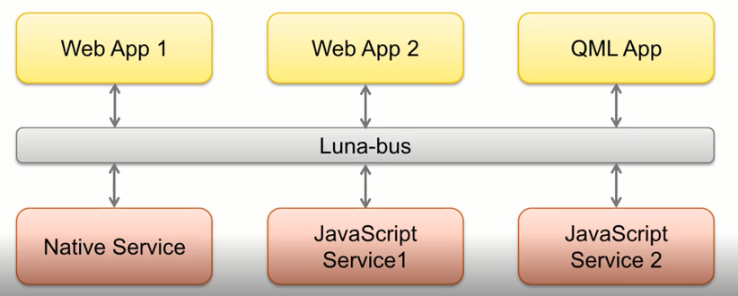
LUNA BUS
Luna-Bus is a message-oriented middleware mechanism that allows communication between multiple processes running concurrently on the same machine.
Message exchange between processes is based on JSON payload, which allow webapps to consume responses directly in webAPP.

Slide 3
Luna bus is composed of:
Central hub daemon provides a central clearing house for all communication.
Client library provides API support to register on the bus and communicate with other components.
Utilities for monitoring and debugging the bus are included.
Methods and Signals
Methods are operations that can be invoked on an Service, with optional input (aka arguments) and gets output response (aka return values /Reply)
Signals are broadcasts from the Service to any interested observers of the signal; signals may contain a data payload

Slide 4
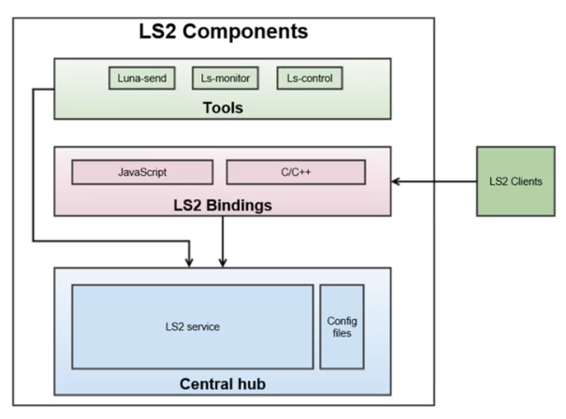
Architecture of Luna Bus
Central hub daemon: Provides a central clearing house for all communication. Utilities for monitoring and debugging the bus are included.
LS2 bindings provides interfaces for client to make luna calls.
Services can register with HUB as LS2 client using JavaScript or C/C++ lib.

Slide 5
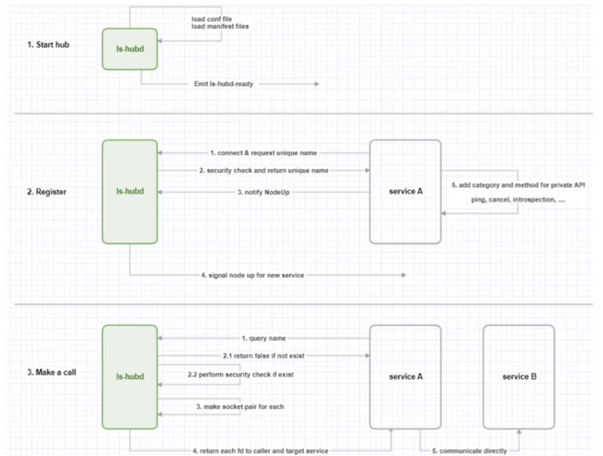
Basic flow to make a luna call
HUB initializes by loading the config and Manifest files.
Services register with hub as luna clients.
Services will expose their methods with bus.
serviceA and serviceB is registered with the HUB.
In order for serviceA to connect to serviceB, the process shown in Figure 3.

Slide 6
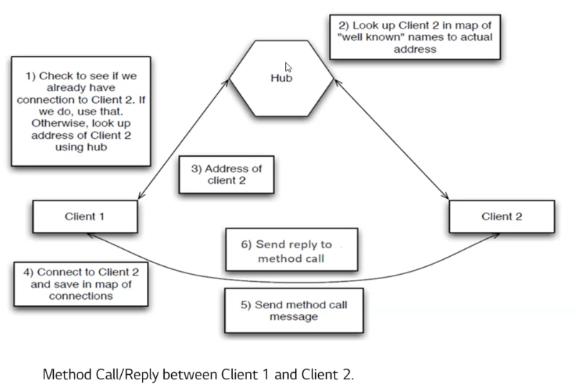
Method calls

Slide 7
Access Control Groups
The purpose of ACG is to protect the integrity of system. It prevents unauthorized access of APIs by clients, as each client must explicitly request permission to use system resources.
Achieved using 4 different types of permission files:
Role file - Security at executable level.
Client Permissions file- Required group permissions.
API file-Categorizes APIs under fine grained groups.
Groups files - Associates trust level for defined API groups.
These files will be:
Manually provided by the developer for built-in services.
Auto generated from services.json file for external services by app installer.
Auto generated from "appinfo.json" for apps by app installer.
A manifest file containing the paths of the above mentioned files is automatically generated and deployed under "Manifest Directories" location.

Slide 8
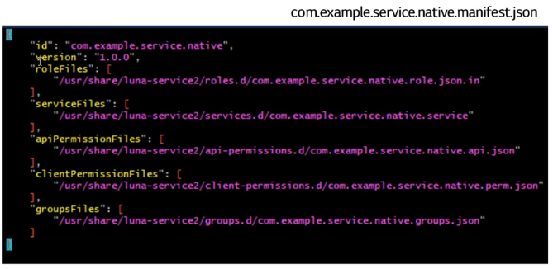
Manifest file
Each service's manifest file contains the locations of:
roleFiles
serviceFiles
apiPermissionsFiles
clientPermissionFiles
groupsFiles

Slide 9
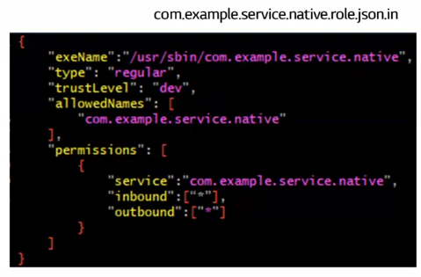
Role file
Role file contains allowed service names for each component and individual security settings for each service name.
exeName - Absolute path of binary executable.
type - Service type (regular / privileged/devmode). Only privileged services are allowed to change "id" during execution
trustLevel-Security permission level of service.
allowedNames - Names that this service is allowed to register. It can be an array of any valid service name strings.
inbound - List of services that this service is allowed to receive requests from.
outbound - List of services that this service is allowed to send requests to.

Slide 10
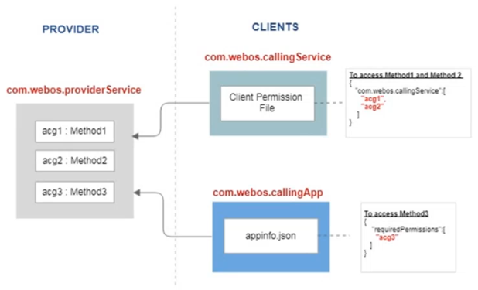
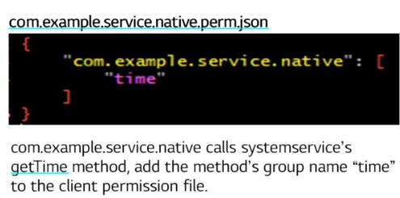
Client permission file
Client permission file defines what groups are required for this component to function properly

Slide 11
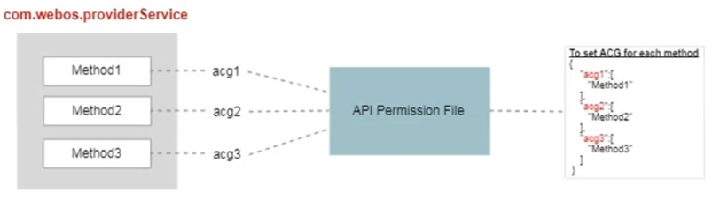
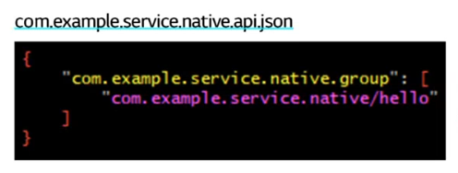
API permission file
API permission file defines what methods are included into security groups this component provides
In this example, the group name is set to "com.example.service.native.group", and the hello method of com.example.service.native is added to this group

Slide 12
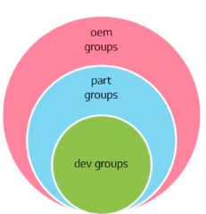
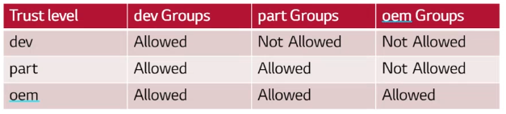
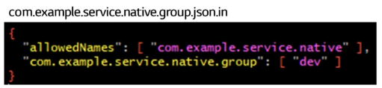
Group permission file
Groups files specifies security trust level of each provided group. Below are the trust levels supported in webOS:
dev - APIs belonging to this trust level can be accessed by all
part - APIs belonging to this trust level can only be accessed by privileged partners
oem - APIs belonging to this level are meant for system services and built in apps and cannot be accessed by any other partners including privileged partners
In this example, the group"com.example.service.native.group" is define as "dev"group.

Slide 13
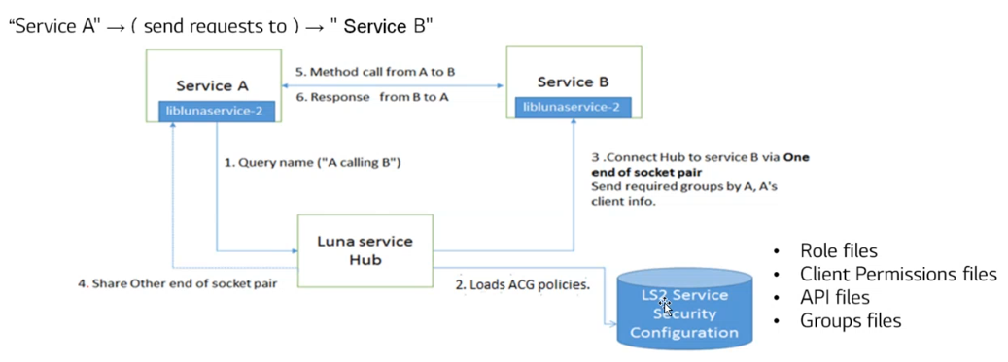
Example
Luna bus enforces security restrictions on three levels:
Executable level-Service registration is possible only if the allowed Name (as given in role file) is used.
Service level- Hub will establish direct connection between two services (if their inbound and outbound permitted).
Method level - Method call will be allowed only if the trustLevel and required client permissions is satisfied by the destination service's provided group permissions.

Slide 14
Features
Multi Language binding support (Support C/C++ library and JS library).
Asynchronous peer-to-peer communication.
Supports one-call-multiple-replies
Signals
Starting services dynamically on demand
Security and policy model
Multiuser support
Support for debugging

Slide 15
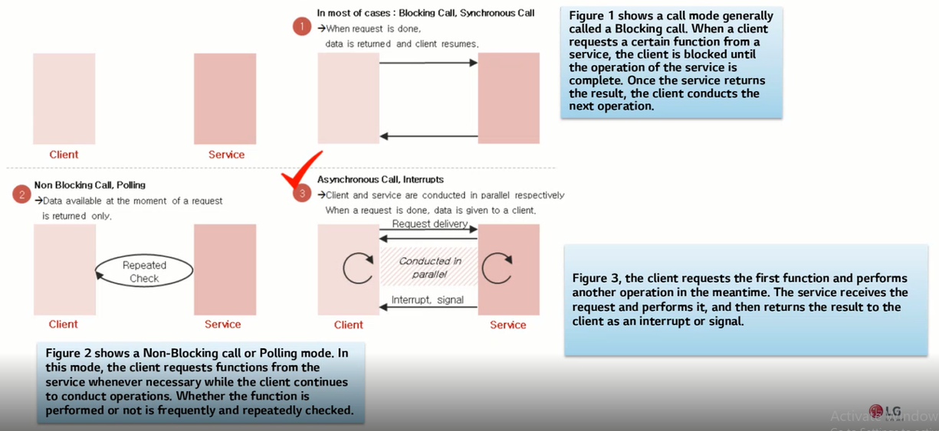

Asynchronous P2P communication
Asynchronous calls will improve application responsiveness

Slide 16
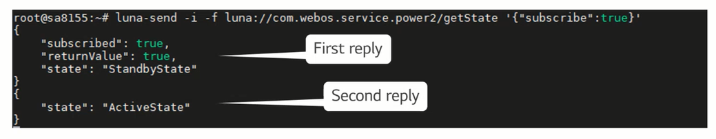
Supports One Call Multiple Replies
One-call-multiple-replies is exclusive feature to Luna Bus. To get multiple replies caller has to set subscribe as true in payload.
Callers will be notified by the service whenever there is any change in data.
Example: Subscription of "getState" which is one time call, any further change in the state it will be notified

Slide 17
Signals
A signal is an event generated by the services in response to a specific condition.
Clients can send (emit) signals. Also, they can register (subscribe) to a particular signal that they wish to listen.
All signals are routed via the hub.
Additionally, Luna bus generates the below signals:
Service status signals (service up/down).
Detailed service status signals (busy / running /ready etc).
Service category registration signals
By default, signals emitted from Luna Bus will not be sent to any clients. To receive signals, clients must explicitly register.

Slide 18
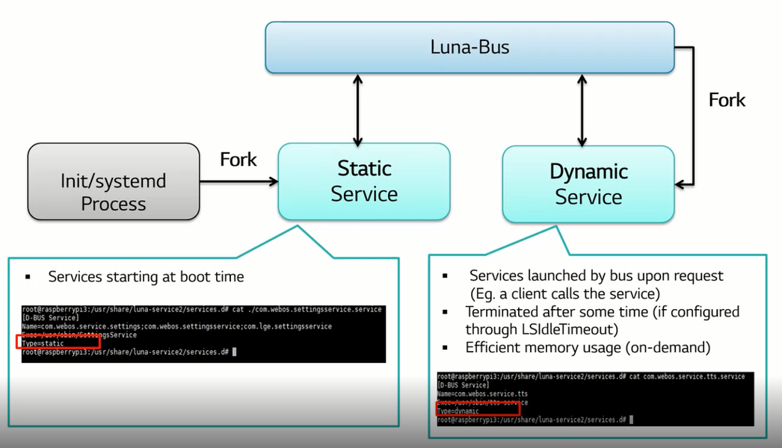
Starting services dynamically on demand

Slide 19
Security and Policy Model
ACG (Access Control Groups) is the security and policy model for LS2 system.
Provides fine grained security model
Allows to define security group containing set of methods.
Method calls will be denied by ACG if application does not satisfy required permissions.
Luna bus enforces security restrictions on three levels:
Executable level - Enforces policy to allow clients registration based on executable name
LS2 Service level - Enforces boundary permissions for a registered service (allowed inbound/outbound communication) with other services
LS2 Method level - Enforces method accessibility permissions based on security groups and trust level.

Slide 20
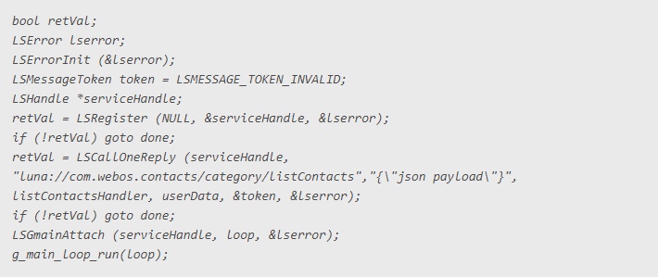
Sample Client Usage (calling the 'listContacts()' method from a registered service):

Slide 21
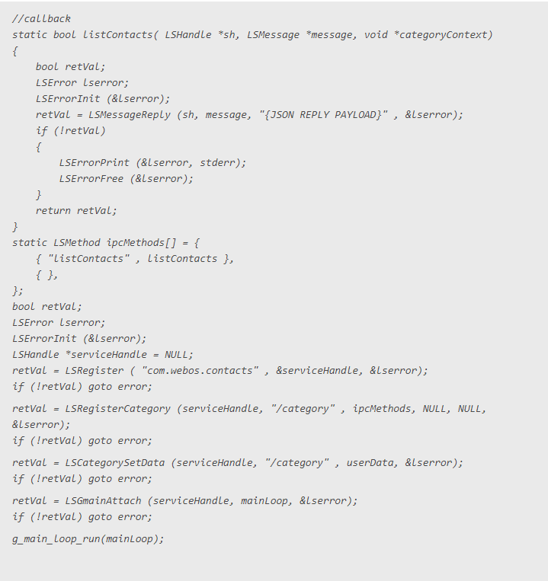
Sample Service Usage

